Slide 1



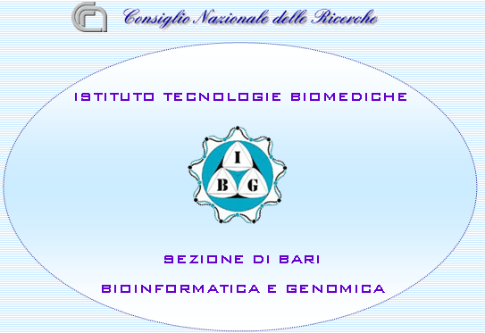














EMBRACE
Web Services Interoperability
Through Standardisation
BioHackathon 2008

Slide 2
EMBRACE
A European Model for Bioinformatics Research and
Community Education
Works to integrate the major databases and software tools in bioinformatics, using existing methods and emerging technologies.
Notes:
European Network of Excellence
Relates to the topic of this meeting.

Slide 3
Partners
European Molecular Biology Laboratory Germany
European Bioinformatics Institute UK
Swiss Institute of Bioinformatics Switzerland
Istituto di Tecnologie Biomediche – Sezione di Bari Italy
The University of Manchester UK
Sveriges Lantsbruksuniversitet Sweden
Centre National de la Recherche Scientifique France
Center for Biological Sequence Analysis Denmark
Consejo Superior de Investigaciones Cientificas Spain
Stockholms Universitet Sweden
Institut National de la Recherche Agronomique France
Max Planck Institute for Molecular Genetics Germany
CSC – Scientific Computing Ltd. Finland
University College London UK
Weizmann Institute of Science Israel
Stichting Katholieke Universiteit The Netherlands
Instituto Nacional de Tecnica Aerospacial Spain
Universitetet i Bergen Norway
Notes:
17 European partners from 12 different countries
Many of the most influential organisations in bioinformatics in Europe
Administered by the EBI

Slide 4
Technology evaluation and recommendation
Initial technology recommendation
Continuous technology evaluation
Notes:
One Work Package of EMBRACE is dedicated to monitor technology developments and provide recommendations.
The initial technology recommendation was provided in September 2006.
It was clear from the beginning that EMBRACE were going to use Web Services. It was even in the proposal text,
It’s main content was a recommendation of providing integration using Web Services as defined by the Web Services Interoperability profile.

Slide 5
Why Use Web Services In The First Place?
Interoperability:
The ability to inter-operate, to work together.
Notes:
Making two pieces of software to communicate over the internet has been done for several decades and can be considered trivial today.
If the only requirement of a software system is to ENABLE communication, there are 1000s of ways to accomplish that.
Under these requirements you might choose to send tab separated text files over http, for instance.
Interoperability is the ability to work together or to inter-operate
More correctly, we should be talking about the DEGREE of interoperability. Any two pieces of software can be made to interoperate. It’s just a matter of effort. Maximise interoperability = minimise the effort it takes to make systems talk to each other
Web Services provides a generic mechanism to make HIGHLY INTEROPERABLE interfaces to software systems.
This is new, and is the reason for the popularity of Web services.
So in summary, if the only requirement is to ENABLE communication, Web services is probably not the way to go. If there is also a requirement to make it easy to talk to other computer systems, Web Services is a good choice.

Slide 6
Web Services Interoperability organisation
Initial Web Service specifications were quite flexible
Web Services Interoperability organisation was founded to establish more restrictive specifications
Notes:
Some history:
Web services started to gain acceptance at the beginning of this decade.
A problem was too flexible specifications, so it was hard to deal with he many different types of services.
All the major IT companies came together and started the WS-I to define more strict standards.
The organisation published the WS-I basic profile
Good, There was now way of making web services that was more interoperable.

Slide 7
Recommendation update
Due in May
How are we doing?
Notes:
We are supposed to provide an update to the technology recommendation by May this year.
So we are currently looking at what is happening in the field and examining our progress.

Slide 8
Building Competence
Many partners are new to XML
Need to invest more in training

Slide 9
Scripting Languages Lagging Behind
Massive efforts had been invested in early adoption of Web Services
WS-I Basic Profile was a kiss of death to several projects based on the RPC style.
Notes:
Bioinformatics has traditionally relied on Perl and other scripting languages, so an obvious observation was that tools for building and using WS-I Web Services was limited in the scripting languages. Some existed, but were not very good.
This was also mentioned in the summary for this meeting.
WS-I lead to a new problem: Developers became frustrated. Scripting languages was quite early to make tools for Web Services, but virtually all focused on the RPC style of making Web Services.
Very different development in the languages mostly used in the computer industry. Web Service tools and technologies are quite mature for the languages most used (like Java + .Net).
WS-I is today the de facto standard for web services, has been so for 4 years.
Tool development in the scripting languages may pick up again.

Slide 10
XML::Compile
New Perl module to work with XML
Fully WS-I compliant
Proper XML binding
Strictly validating
Notes:
Example of new addition. There are others. ZSI for Python.
Perl is vital
This was working from November last year.
Strictly validating
Uses C for XML parsing
Represent a higher level of maturity than any other tool for scripting languages that I know of
You can:
Ask how a request to a service you have not used before should look like.
Get an error message if a request is not valid without sending anything to the service. Exactly what is wrong.
Really simplifies debugging.
Possible improvements:
Simplified usage
MTOM support
Wish to give demo, but not enough time. Anybody interested can get a intro.

Slide 11
Service Oriented Architecture
Functionality is expressed as services.
Each service provides one clearly defined basic functionality.
Higher level functionality is achieved using service composition.
SOA ≈ WS-I Web Services
Notes:
Another observation is the massive use of Service Oriented Architecture, which is a way of designing large software systems based on the concept of services.
The talk by Lincoln Stein where talk about the bioinformatics nation, he describes a SOA.
A service in a SOA can be implemented in different ways. But the most common way to implement is by using WS-I Web Services. Typically WS-I is used for most services, together with some other technologies for some individual services within the same architecture.
SOA = WS-I Web Services everywhere you hear about SOA.
Web services are great to implement a SOA because it makes every service accessible in the same way. Just like lego: They look the same and fit together.
In particular, it the property of exposing the data model used by a service that makes WS interoperable, since clients can determine how to communicate with a service by inspecting it’s data model.

Slide 12
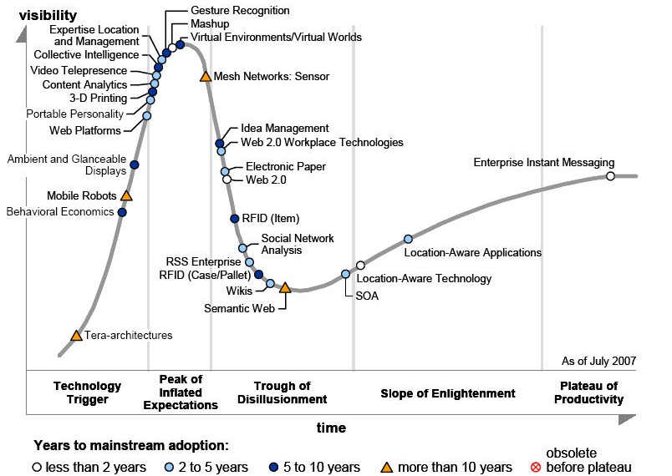
Gartner Hype Cycle For Emerging Technologies
Notes:
Some of you are probably familiar with the Gartner Hype Cycle.
X- Axis: time
Y- Axis: attention
All emerging technologies seem to follow the same pattern: trigger-peak-trough-slope-plateau
SOA: on the slope with 2-5 years until fully productive.
Tool development in the scripting languages was most active around the peak.
Reference: Semantic Web is considered to be more than 10 years in the future.

Slide 13
SOA Is Mainstream
  SAP
  Oracle
  IBM
  Microsoft
Notes:
Gartner is quite conservative.
SOA has lost it’s cutting edge and is now a part the mainstream IT industry.
Every major software vendor in middleware has implemented on SOA.
SAP is the German solution for managing businesses. Both SAP and all the competitors are building their solutions with SOA.

Slide 14
SOA Is A Part Of Society
Existing SOA implementations in Norway:
  All parts of government
  Police
  Banks
  Major hospitals
  Companies
Notes:
I know Norway the best, but this is not a particular Norwegian phenomenon
If you pay attention to what is happening in the IT industry, you have heard about these development. It’s world wide.
Several of the people I studied with and are now working as consultants, work with SOA.
On a regular basis we hear of a new company or part of government that implements a SOA.
All in all it is clear that SOA / Web Services is becoming a widely adopted technology in several sectors of society.

Slide 15
What do we get from WS-I ?
Tools and technologies
Massive development efforts
Available competence
Safety

Slide 16
Preliminary thoughts
Original recommendation was on track
Tools for the scripting languages seems to improve
Need more training

Slide 17
Future directions
Common data types
Semantic annotation
Notes:
Common data types expressed in XML Schema
EMBRACE will work together with as many other people to define common data types to be used by EMBRACE
Semantic annotation:
As with everything in Web Services: standards and interoperability.
It’s not about making it work, but making it interoperable.
Long term W3C will provide good standards for this. They are currently working on this.
Meanwhile: Creeping adoption that keeps everything working.
Ex. Placing ontology terms in element attributes.
Ex. Semantic annotation of service functionality in the WSDL
Ex: Use the Open Biomed Ontologies
Ex: Using existing XML formats

Slide 18
The EMBRACE Technology Watch and Recommendation
Ann-Charlotte Berglund
Vincent Breton
Jose-Maria Carazo
Giuseppe Fiameni
Taavi Hupponen
Jr. Macias
Elda Rossi
Jean Salzemann
Heinz Stockinger

